Slide 1


Bankruptcy Prediction
By – Yudhvir Mor(1191) and
Vineet Kapoor(11910076)
ISB CBA Practicum
8th February , 2019

Slide 2
Table Of Contents
Executive Summary
Business Problem
Introduction
Methodology & Tools
Models
Message
Means
Analytics Approach
Connecting CBA Term – 3 courses
Data collection & cleaning
Data Understanding
Analysis & Results

Slide 3
Data Preparation
Modelling & Evaluation
Business Recommendation
Assumptions, Limitations.
References.

Slide 4
Executive Summary
There exist a strong correlation between many ratios.
The Features are skewed and have many outliers.
SMOTE technique is applied to balance the classes and upsample the minority class.
Missing values are imputed by median imputation.
The features are scaled by log(1+x). The features are also normalized.
Test and Training set accuracies are almost 90%.
AUROC AND F1 scores are computed for all the models and compared.

Slide 5
Methodology and Tools
Step 1
Step 2
Step 3
The data was cleaned and missing data is imputed. The data was imbalanced. So, minority samples were balanced using SMOTE techniques.
The Dataset was analysed using correlation heatmaps. And, the correlated features are removed form data. Business context was used to define the features.
Data was taken for only year 1 and year 3. Scaling of data is done and then , data is normalized.
Step 4
Step 5
Step 6
Training and Test sets accuracy are plotted for each classifier.
The training and validation data was created using sampling and K- fold cross validation. The whole modelling exercise is done on python using sklearn package.
Methods used for performing regression models are
ANN
KNN
Random Forest
Adaboost Classifier
GBM classifier
6. Optimization of Hyperparameters is also performed using Grid Search CV method.

Slide 6
Business Problem
Predicting the Bankruptcy rate of companies in 1 , 2, 3 , 4 , 5 years. There are 64 features and one target variable. To understand and analyse each of the 64 attributes along with 10,503 examples given and build a predictive model for bankruptcy rate of a given company.
To find the factors responsible for Bankruptcy.

Slide 7
Introduction
Bankruptcy of a firm is dependent on major 5 factors , they are
Working capital/ total assets., retained earnings/total assets, EBIT / total assets , book value of equity / total liabilities , sales / total assets.
The probability of company going bankrupt in 1 year and 3 years is predicted using all the features first, then only few features were used on the basis if their importance and collinearity with other features.
The external factors are also there which causes bankruptcy for a firm, they are global economic slowdown, consumer confidence might decline and that can lead to slow revenue.
Competitions from other firms can lead to cut in the revenue of small firms and can be a cause of bankruptcy.

Slide 8
Analytic Approach
The data was cleaned and missing data is imputed. The data was imbalanced. So, minority samples were balanced using SMOTE and ADASYN techniques.
The Dataset was analysed using correlation heatmaps. And, the correlated features are removed form data. Business context was used to define the features.
Data was taken for only year 1 and year 3. Scaling of data is done and then , data is normalized.
The training and validation data was created using sampling and K- fold cross validation. The whole modelling exercise is done on python using sklearn package.
Methods used for performing regression models are
ANN, KNN,Random Forest, Adaboost Classifier, GBM classifier,Optimization of Hyperparameters is also performed using Grid Search CV method.

Slide 9
Models
ANN- Artificial Neural Network using Keras.
GBM – Gradient Boosting Classifier model
KNN Classifier model
Bagging Classifier
SVM classifier
Decision trees
Random Forest model
Hyperparameter tuning using Grid Search CV method
K fold Cross validation model.

Slide 10
Message
Bankruptcy Rate prediction is done for first year and third year data. The data points are assumed to be original and missing data as MSNR.

Slide 11
Means
Visualization Tools - Python
Modelling Tools – ANN, Random Forest, KNN, SVM, Decision Trees, GBM, Adaboost, Bagging classifier, Random forest packages from sklearn are used.
Packages used in Python: numpy, pandas, matplotlib, seaborn, StandardScaler, statsmodels.formula.api, Scipy, msno

Slide 12
Connecting CBA Term – 3 courses
ANN using Keras, Random Forest, GBM, AdaBoost, missing data imputation, KNN, Evaluation of Models using test and training sets accuracy and optimizing the Hyperparameters using Grid search method.
Statistics -3, DMG-2, Deep learning, Financial Analytics

Slide 13
Data collection & cleaning
The data was provided already.
Median imputation technique is used for missing data.
Preprocessing of data is done by balancing the data using SMOTE techniques. and normalizing using Log(1+x).
Feature engineering is done.

Slide 14
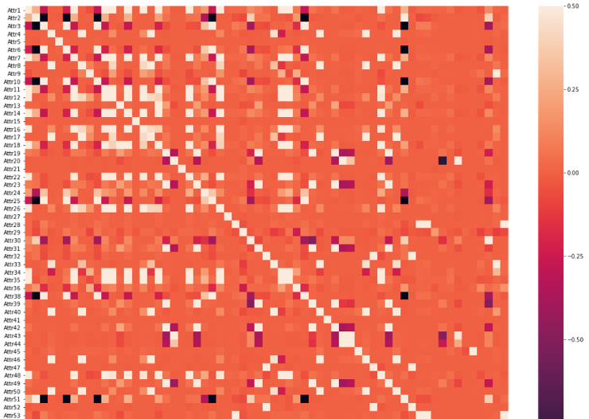
Data Analysis of features

Slide 15
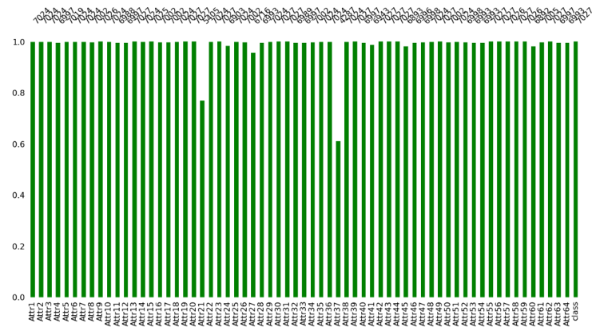

Slide 16
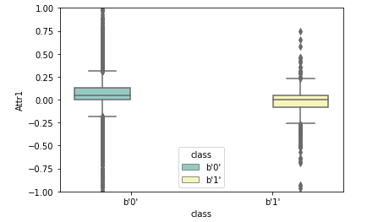
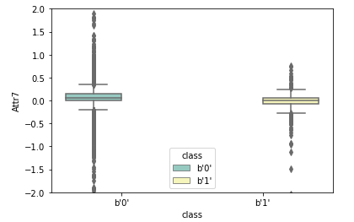
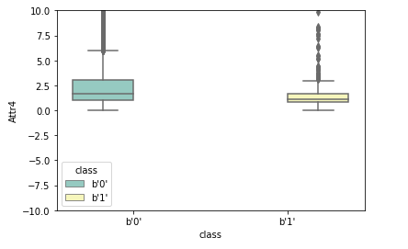
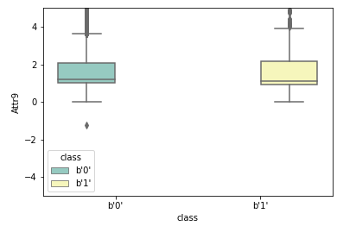
Backward Elimination Process

Slide 17
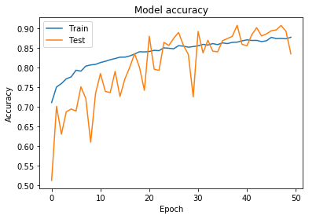
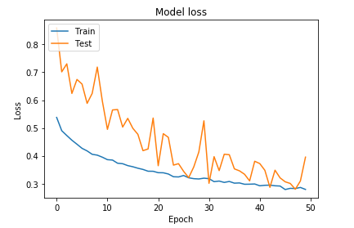
MLP using Keras
Hidden Layers – 3
Epochs – 50
Batch Size – 10
Optimizer – Adam
Activation Function – el Relu and Sigmoid
Loss – Binary Crossentropy
Validation split – 0.25
True Positive – 2206
True Negative - 2661
False Positive - 660
False Negative - 102
Accuracy – 0.86

Slide 18
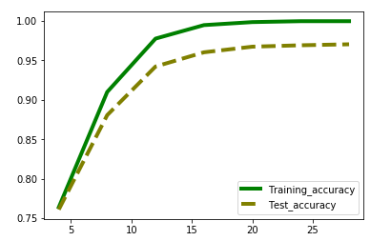
Random Forest Model
Max_depth of the trees is chosen as important hyperparameter and plots of Training and test accuracies are made on the basis of different values of Max_depth.

Slide 19
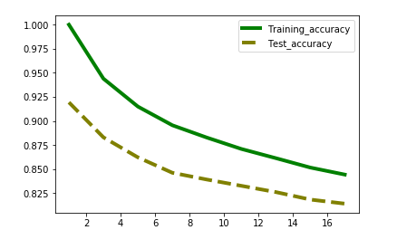
KNN
n_neighbours of the KNN classifier is chosen as important hyperparameter and plots of Training and test accuracies are made on the basis of different values of n_neighbours

Slide 20
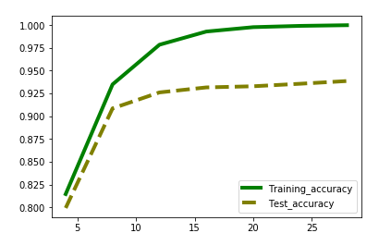
Decision Trees
Max_depth of the trees is chosen as important hyperparameter and plots of Training and test accuracies are made on the basis of different values of Max_depth

Slide 21
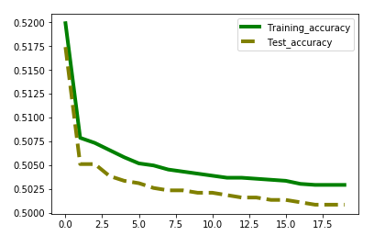
Naïve Bayes
Var_smoothing of the trees is chosen as important hyperparameter and plots of Training and test accuracies are made on the basis of different values of smoothing constant.

Slide 22
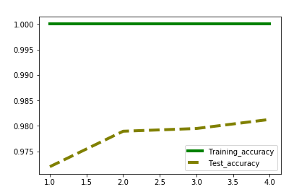
AdaBoost Classifier
Learning rate of the Random Forest classifier is chosen as important hyperparameter and plots of Training and test accuracies are made on the basis of different values of Learning Rate

Slide 23
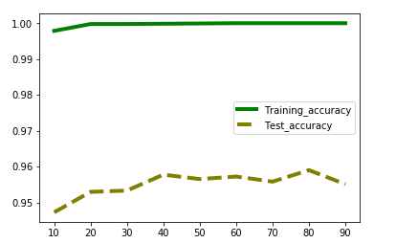
Bagging Classifier
n_estimators is chosen as important hyperparameter and plots of Training and test accuracies are made on the basis of different values of n_estimators

Slide 24
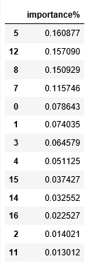
Features importance plot
Features importance table using Random Forest model.

Slide 25
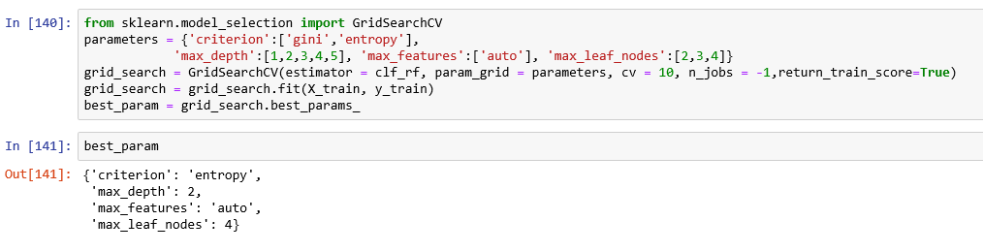
Grid search optimization method
Applying Grid search method #Optimization techniques. The method has been applied on Random Forest Classifier model. The parameters are chosen and are used for further analysis.

Slide 26
Modelling, evaluation
Accuracy Score is used to check the accuracies of the model. The values in given data are assumed to be correct and there are no assumptions taken while making classifier models.
AUROC score is used for evaluating other models. and confusion matrix for ANN model.

Slide 27
Business Recommendation
The data can be cleaned further to improve accuracy of predictions.
The OPTIMIZATION TECHNIQUES can be used for optimizing the model.
Tensorflow can also be used for making MLP model for the data to improve accuracy and features importance

Slide 28
Assumptions, Limitations:
The model was made only for 2 years.
The features in dataset are not normal.

Slide 29
References
https://smallbusiness.chron.com/causes-business-bankruptcy-49407.html
http://www.shenehon.com/measuring-companys-risk-bankruptcy/
https://www.investopedia.com/articles/active-trading/081315/financial-ratios-spot-companies-headed-bankruptcy.asp

